Slide 1
Air Quality for all Improving air quality in large cities using mobile phone, IoT and open data WP.T 6.10 (and 5)
Richard Benjamins, Pedro de Alarcón, Javier Carro, TID (Telefónica)
Start: Sept 2020
End: August 2021
PMs from Humane AI: 6,45
PMs from outside Humane AI: 2
Notice that this is the first MP of three related MPs, each tackling a specific aspect of the innovation life cycle. MP3 involves partners from WP5

Slide 2
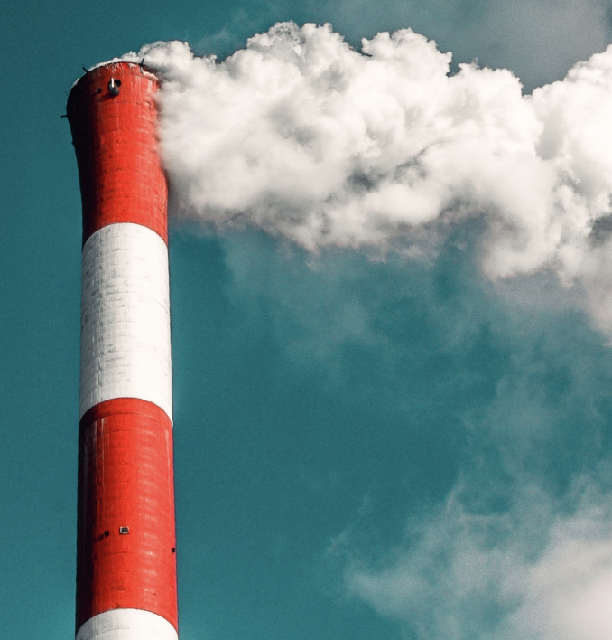
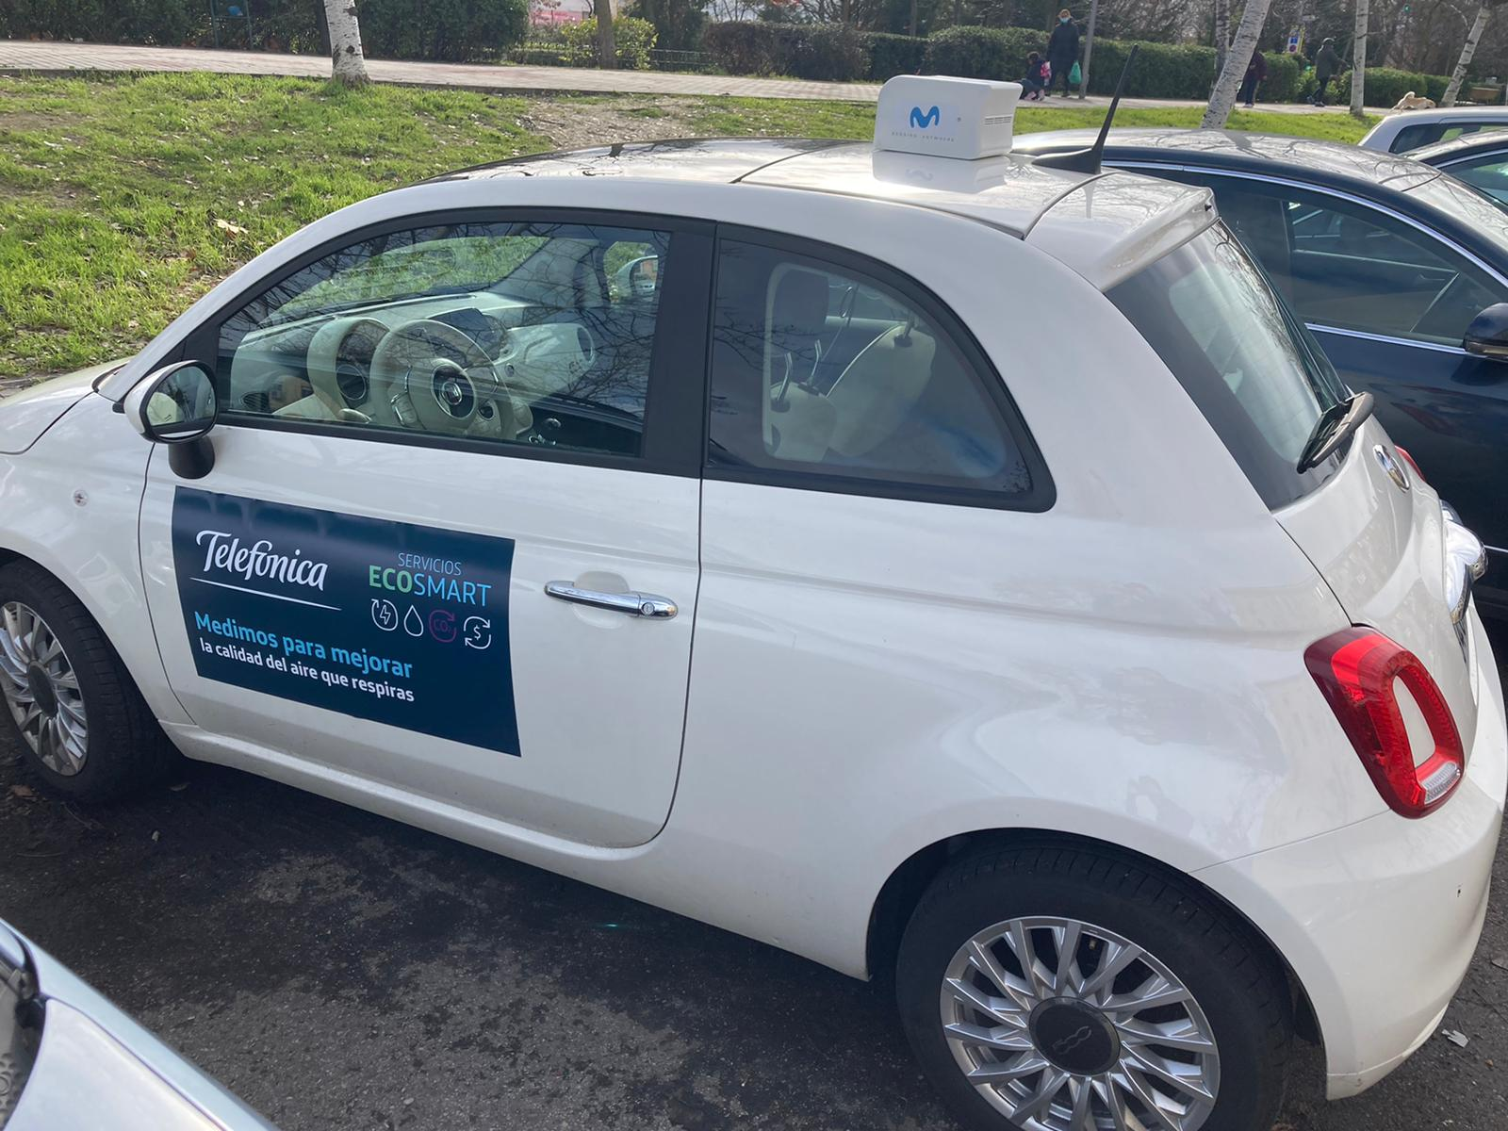
Project Aim and Idea
Problem to solve
Health
Worldwide, 9 out of 10 persons breadth polluted air
Worldwide, 7 million people die because bad air quality
Public policymaking
Large cities systematically suffer from bad air quality, but don’t have agile tools to manage it
New regulations force cities to limit air quality emissions
On what idea is the solution based
30% of Greenhouse-effect direct emissions are produced by transport (traffic in cities)
The telco industry has differential anonymized, aggregated mobility data that, using AI algorithms, can be turned into a proxy for traffic in cities (using AI algorithms)
Mobile air quality sensors placed on top of cars provide street-level measurements. This sensors are complementary to traditional air quality monitoring stations.
Combining this with open data provides more granular – both in time and geography - insights for better policymaking and policy monitoring
The social and ethical impact of the decisions will be checked with data from statistical offices
Why is it important for Humane AI Net
Bringing innovative applications to the telco industry beyond traditional connectivity services
Contributing with AI to solving an important societal problem occurring every where in the world (%56 of world population in 2020, and estimated to grow to 68% in 2050)
Providing real experience on the ethical and societal impact of data and AI-driven decisions in public administrations

Slide 3
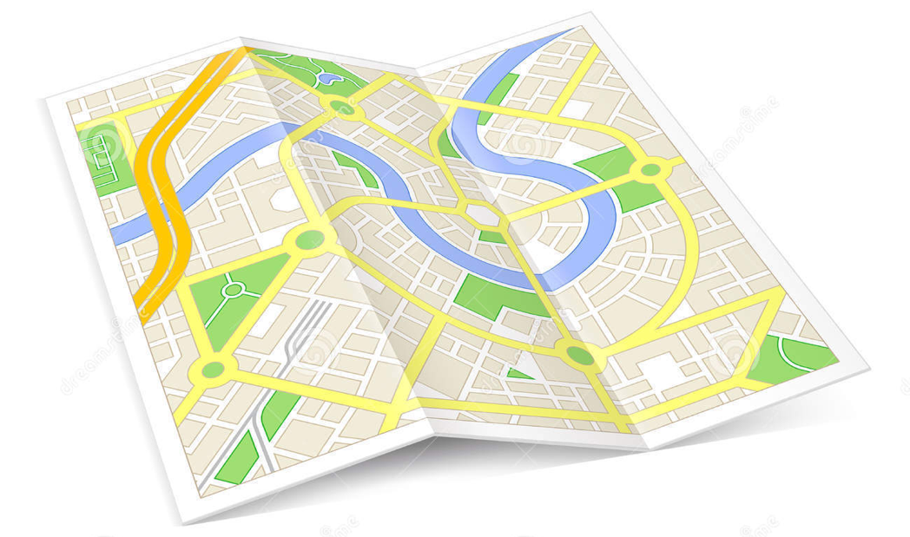
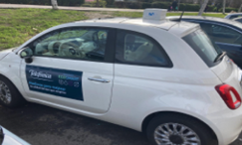
Combining privately-held data and open data
Privately-held data
Open data
MOBILE AIR QUALITY SENSING
Sensors installed on rooftops of vehicles that allow AQ hyperlocal mapping
FIXED AIR QUALITY STATIONS
High quality open data from the 24 stations deployed by Madrid city gov.
VEGETATION INDEX (NDVI)
Open data index constructed from satellite imagery at block-level granularity
MOBILITY (CELLPHONE ACTIVITY)
Mobility levels from cell phones log data help to understand population dynamics wrt air pollution levels
WEATHER (AEMET)
Climate is key to explain AQ levels fluctuations.
GEO. ADMIN. OBJECTS
Admin objects are the “anchors” to relate data sources
TRAFFIC SENSORS
Road sensors counting the number of cars
INE (NSO)
Census data

Slide 4
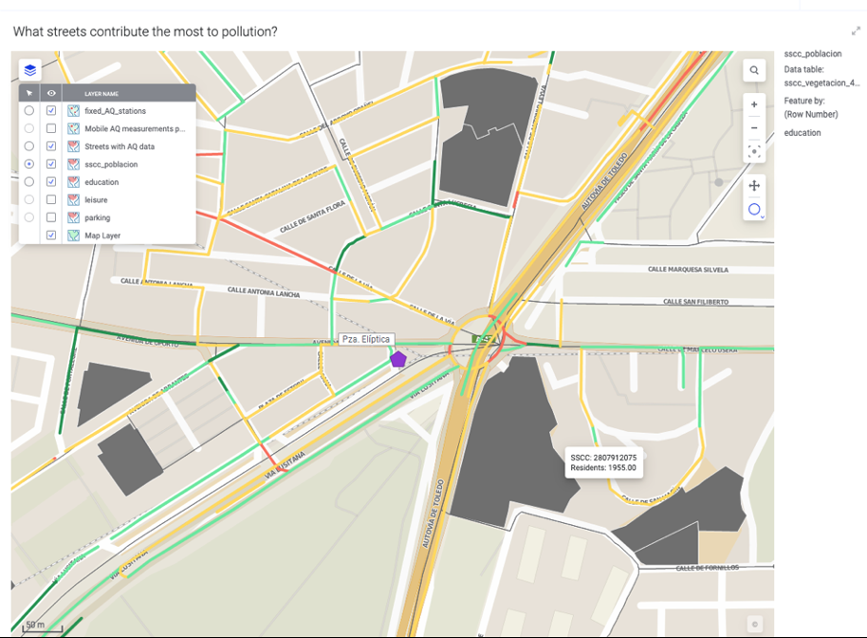
Supporting local governments in monitoring and managing air quality at street level
Some tool functionalities:
Monitor AQ at street-level resolution
Monitor how many inhabitants are affected by a certain quality of air and what day and time
Origin analysis of air pollution
Monitor air quality at specific times close to specific buildings such as primary schools, hospitals, residences
Monitor the influence of vegetation on air quality
Understand the relationship between traffic and climate for air quality at street level
Some highlighted use cases:
Investigate hotspots of pollution for compliance with regulation
Transport planning
Management of traffic and mobility in the city
Definition and monitoring of low emission zones
Urgent interventions for public health
Transparency for citizens at Street level

Slide 5
Results
What did you learn in the course of the project ?
AI and Data can bring important improvements to better manage air quality in large cities
The innovation is based on the use of existing technology and data sources
Costs are relatively low as many data sources already exist and hardware equipment is reused.
City governments require training to integrate “evidence-based policymaking” in their daily routine
What tangible results did the project produce and how are they being made available to the community
A pilot for the city of Madrid
A platform to easily replicate to other cities around the world
Inclusion of the service in Telefonica B2B Smart Cities offering related to EU Recovery and Resilience Funds and new European regulation on air quality
Business plan
Free piloting for “early adopter” cities

