Slide 1
Proposed AI Act General, definition, prohibitions

Slide 2
AIA
Title I: General Provisions
Title II: Prohibited AI Practices
Title III: High-risk systems
Title IV: Transparency obligations for certain systems
Title V: Measures in support of innovation
Title VI: Governance
Title VII: EU database for stand-alone high-risk AI systems
Title VIII: Post-market monitoring, information sharing, market surveillance
Title IX: Codes of Conduct
Title X: Confidentiality and penalties

Slide 3
Title I General Provisions
Art. 1 subject matter
Art. 2 scope of application
Art. 3 definitions

Slide 4
Subject matter art. 1
harmonised rules for the placing on the market, the putting into service and the use of artificial intelligence systems (‘AI systems’) in the Union;
prohibitions of certain artificial intelligence practices;
specific requirements for high-risk AI systems and obligations for operators of such systems;
harmonised transparency rules for AI systems intended to interact with natural persons, emotion recognition systems and biometric categorisation systems, and AI systems used to generate or manipulate image, audio or video content;
rules on market monitoring and surveillance.

Slide 5
Definition AI System art. 3(1)
‘artificial intelligence system’ (AI system) means:
software that
is developed with one or more of the techniques and approaches listed in Annex I
and can for a given set of human-defined objectives,
generate outputs such as content, predictions, recommendations, or decisions influencing the environments they interact with;

Slide 6
Definition AI System ANNEX I
Machine learning approaches, including supervised, unsupervised and reinforcement learning, using a wide variety of methods including deep learning;
Logic- and knowledge-based approaches, including knowledge representation, inductive (logic) programming, knowledge bases, inference and deductive engines, (symbolic) reasoning and expert systems;
Statistical approaches, Bayesian estimation, search and optimization methods.

Slide 7
Definition AI System art. 3(1) and ANNEX I
Definition has a broad scope and is meant to provide broad protection
It is not about what AI truly is (no metaphysical discussions)
Meant to provide ‘effective and practical protection’
The discussion should be about:
whether in concrete AI systems, applications or practices
the right level of protection has been implemented

Slide 8
Definition Provider art. 3(2)
‘provider’ means
a natural or legal person, public authority, agency or other body
that develops an AI system or
that has an AI system developed with a view to placing it on the market or putting it into service under its own name or trademark,
whether for payment or free of charge;

Slide 9
Definition User art. 3(4)
‘user’ means
any natural or legal person, public authority, agency or other body
using an AI system under its authority,
except where the AI system is used in the course of a personal non-professional activity;

Slide 10
Definition Operator art. 3(8)
‘operator’ means
the provider,
the user,
the authorised representative,
the importer and
the distributor;

Slide 11
Definition Placing on the market art. 3(9)
‘placing on the market’ means
the first making available of an AI system on the Union market;

Slide 12
Definition Making available on the market art. 3(10)
‘making available on the market’ means
any supply of an AI system for distribution or use
on the Union market in the course of a commercial activity,
whether in return for payment or free of charge;

Slide 13
Definition Putting into service art. 3(11)
‘putting into service’ means
the supply of an AI system for first use
directly to the user or
for own use on the Union market for its intended purpose;

Slide 14
Definition Intended purpose art. 3(12)
‘intended purpose’ means
the use for which an AI system is intended
by the provider,
including the specific context and conditions of use,
as specified in the information supplied by the provider in the instructions for use, promotional or sales materials and statements, as well as in the technical documentation;

Slide 15
Definition Reasonably foreseeable misuse art. 3(13)
(13) ‘reasonably foreseeable misuse’ means
the use of an AI system
in a way that is not in accordance with its intended purpose,
but which may result from reasonably foreseeable human behaviour
or interaction with other systems;

Slide 16
Definition Performance of an AI system art. 3(18)
‘performance of an AI system’ means
the ability of an AI system to achieve its intended purpose;

Slide 17
Definition Performance of an AI system art. 3(20)
‘conformity assessment’ means
the process of verifying
whether the requirements set out in Title III, Chapter 2 of this Regulation relating to an AI system
have been fulfilled;

Slide 18
Definition Substantial modification art. 3(23)
‘substantial modification’ means
a change to the AI system following its placing on the market or putting into service
which affects the compliance of the AI system with the requirements set out in Title III, Chapter 2 of this Regulation or
results in a modification to the intended purpose for which the AI system has been assessed;

Slide 19
Definition Post-market monitoring art. 3(25)
‘post-market monitoring’ means
all activities carried out by providers of AI systems
to proactively collect and review
experience gained from the use of AI systems they place on the market or put into service
for the purpose of identifying any need to immediately apply any necessary corrective or preventive actions;

Slide 20
Definition Training, validation and test data art. 3(29,30,31)
‘training data’ means data used for training an AI system through fitting its learnable parameters, including the weights of a neural network;
‘validation data’ means data used for providing an evaluation of the trained AI system and for tuning its non-learnable parameters and its learning process, among other things, in order to prevent overfitting; whereas the validation dataset can be a separate dataset or part of the training dataset, either as a fixed or variable split;
‘testing data’ means data used for providing an independent evaluation of the trained and validated AI system in order to confirm the expected performance of that system before its placing on the market or putting into service;

Slide 21
Definition Input data art. 3(32)
input data’ means
data provided to or directly acquired by an AI system
on the basis of which the system produces an output;

Slide 22
Definition Serious incident art. 3(44)
‘serious incident’ means
any incident that directly or indirectly leads, might have led or might lead to any of the following:
the death of a person or serious damage to a person’s health, to property or the environment,
a serious and irreversible disruption of the management and operation of critical infrastructure.

Slide 23
Title II Prohibited AI practices Art. 5.1
the placing on the market, putting into service or use of an AI system that
deploys subliminal techniques beyond a person’s consciousness
in order to materially distort a person’s behaviour
in a manner that causes or is likely to cause
that person or another person physical or psychological harm;

Slide 24
Title II Prohibited AI practices Art. 5.1
the placing on the market, putting into service or use of an AI system
that exploits
any of the vulnerabilities of a specific group of persons
due to their age, physical or mental disability,
in order to materially distort the behaviour of a person pertaining to that group
in a manner that causes or is likely to cause
that person or another person physical or psychological harm;

Slide 25
Title II Prohibited AI practices Art. 5.1
the placing on the market, putting into service or use of AI systems
by public authorities or on their behalf
for the evaluation or classification of the trustworthiness of natural persons
over a certain period of time
based on their social behaviour or known or predicted personal or personality characteristics,
with the social score leading to either or both of the following:

Slide 26
Title II Prohibited AI practices Art. 5.1
the placing on the market, putting into service or use of AI systems
(…)
with the social score leading to either or both of the following:
detrimental or unfavourable treatment of certain natural persons or whole groups thereof in social contexts which are unrelated to the contexts in which the data was originally generated or collected;
detrimental or unfavourable treatment of certain natural persons or whole groups thereof that is unjustified or disproportionate to their social behaviour or its gravity;

Slide 27
Title II Prohibited AI practices Art. 5.1
the use of ‘real-time’ remote biometric identification systems
in publicly accessible spaces
for the purpose of law enforcement,
unless and in as far as such use is strictly necessary for one of the following objectives:

Slide 28
Title II Prohibited AI practices Art. 5.1
the use of ‘real-time’ remote biometric identification systems
(…)
unless and in as far as such use is strictly necessary for one of the following objectives:
the targeted search for specific potential victims of crime, including missing children;
the prevention of a specific, substantial and imminent threat to the life or physical safety of natural persons or of a terrorist attack;
the detection, localisation, identification or prosecution of a perpetrator or suspect of a criminal offence referred to in (…) and punishable in the Member State concerned by a custodial sentence or a detention order for a maximum period of at least three years, as determined by the law of that Member State.

Slide 29
Title II Prohibited AI practices Art. 5.2,3,4
Conditions for exception to prohibition under 1.d
Requirement of prior authorisation by a judicial or independent administrative authority for each individual use under the exception to prohibition under 1.d
Requirement of Member State legislation for exception to prohibition under 1.d

Slide 30
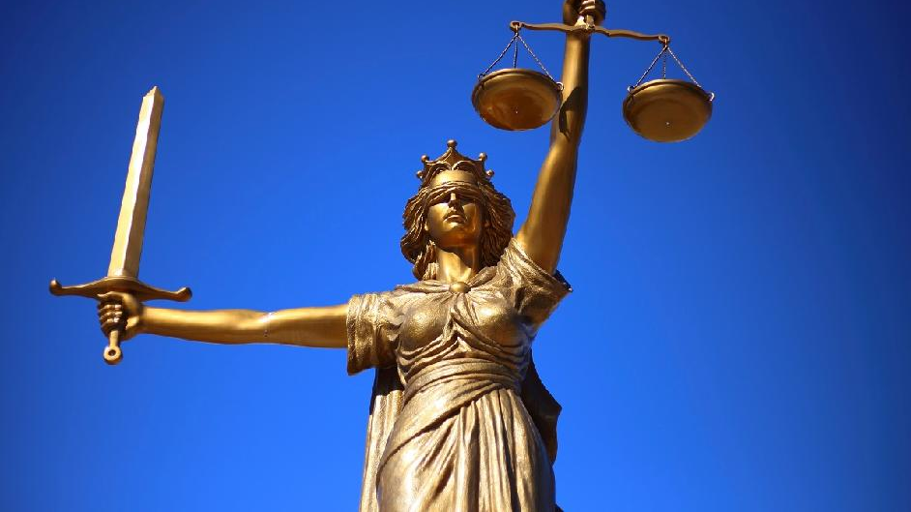
HumanE-AI-NET
AI Act: enables, prohibits, restricts
Reasonable?
Pertinent?

