Slide 1
Developers USERS End-users art. 4 GDPR

Slide 2
Developers
A developer of an AI system is not necessarily its user
The GDPR applies to the developer if they process personal data
to e.g. to test the system

Slide 3
Developers
A developer of an AI system is not necessarily its user
The GDPR applies to the developer if they process personal data
to e.g. to test the system
In the case of research in the public interest the research exception may apply
the GDPR applies, but with less constraints

Slide 4
Developers
A developer of an AI system is not necessarily its user
The GDPR applies to the developer if they process personal data
to e.g. to test the system
In the case of research in the public interest the research exception may apply
the GDPR applies, but with less constraints
The developer is liable as
a controller if they determine the purpose and means
a processor insofar as they act on behalf of an identifiable other

Slide 5
Users
The company, government agency or NGO who employs the system

Slide 6
Users
The company, government agency or NGO who employs the system
Is liable as a controller, if
they processes personal data and de facto determine purpose and the means
note they can delegate details concerning the means to a processor

Slide 7
Users
The company, government agency or NGO who employs the system
Is liable as a controller, if
they processes personal data and de facto determine purpose and the means
note they can delegate details concerning the means to a processor
Is liable as a processor, if
they processes the personal data on behalf of another
note that written agreement required
if they also process for own purposes they are also liable as a controller

Slide 8
Users
The company, government agency or NGO who employs the system
Is liable as a controller, if
they processes personal data and de facto determine purpose and the means
note they can delegate details concerning the means to a processor
Is liable as a processor, if
they processes the personal data on behalf of another
note that written agreement required
if they also process for own purposes they are also liable as a controller
Is liable as a joint controller insofar as they jointly decide on purpose and means
this entails joint several liability

Slide 9
Developers
Compliance by design:
if based on a minimalist attitude wrong attitude
Montesquieu’s spirit of the law
Legal Protection by design:
Foresee potential impact of application
Develop mitigating measures
Focus on rule of law checks & balances
Integrate effective protection of fundamental rights

Slide 10
Developers
Nature Medicine Consensus Statement September 2020
The extension of the 2010 CONSORT* guidelines for clinical trials
CONSORT-AI extension
Reporting guidelines for
clinical trial reports for
interventions involving artificial intelligence:
*consolidated standards of reporting trials

Slide 11
Developers
Nature Medicine Consensus Statement September 2020
The extension of the 2013 SPIRIT* statement
The SPIRIT-AI extension
Guidelines for clinical trial protocols
for interventions involving artificial intelligence:
*Standard Protocol Items: Recommendations for Interventional Trials

Slide 12
Data subject
Art. 4(1) ‘personal data’ means
any information relating to an identified or identifiable natural person (‘data subject’);
an identifiable natural person is one who can be identified,
directly or indirectly,

Slide 13
Data subject
Art. 4(1) ‘personal data’ means
any information relating to an identified or identifiable natural person (‘data subject’);
an identifiable natural person is one who can be identified,
directly or indirectly,
in particular by reference to an identifier such as a name, an identification number, location data, an online identifier or
to one or more factors specific to the physical, physiological, genetic, mental, economic, cultural or social identity of that natural person;

Slide 14
Data controller
Art. 4(7) ‘controller’ means
the natural or legal person,
public authority, agency or
other body which, alone or jointly with others,
determines the purposes and means of the processing of personal data;
where the purposes and means of such processing are determined by Union or Member State law, the controller or the specific criteria for its nomination may be provided for by Union or Member State law;

Slide 15
Data processor
Art. 4(8) ‘processor’ means
a natural or legal person,
public authority, agency or other body
which processes personal data on behalf of the controller;

Slide 16
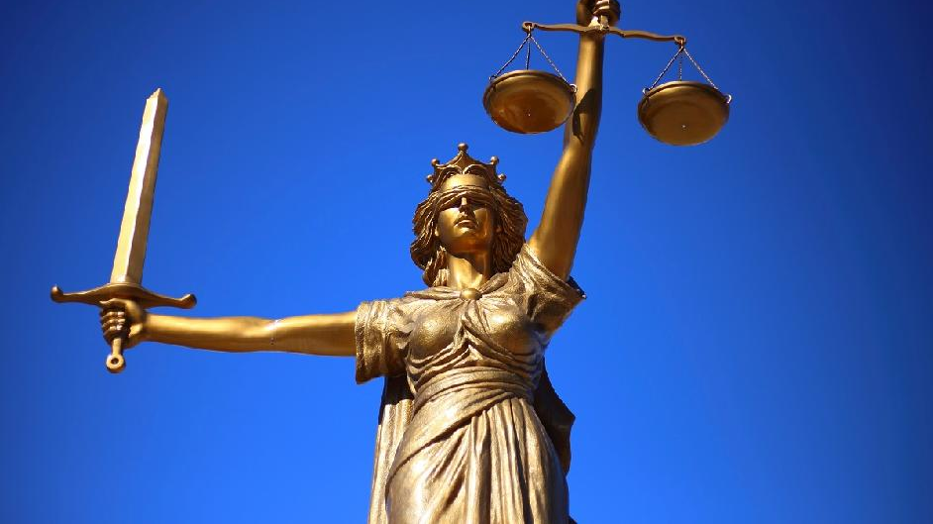
HumanE-AI-NET
GDPR: enables, prohibits, restricts
Reasonable
Pertinent

