Slide 1

Proposed AI Act
What are high-risk AI systems?

Slide 2
AIA
Title I: General Provisions
Title II: Prohibited AI Practices
Title III: High-risk systems
Title IV: Transparency obligations for certain systems
Title V: Measures in support of innovation
Title VI: Governance
Title VII: EU database for stand-alone high-risk AI systems
Title VIII: Post-market monitoring, information sharing, market surveillance
Title IX: Codes of Conduct
Title X: Confidentiality and penalties

Slide 3
Chapter 1:
Classification rules for high-risk AI systems

Slide 4
Chapter 1
Art. 6.1
Irrespective of whether an AI system is placed on the market or put into service independently from the products referred to in points (a) and (b),
that AI system shall be considered high-risk where both of the following conditions are fulfilled:
  the AI system is intended to be used as a safety component of a product, or is itself a product, covered by the Union harmonisation legislation listed in Annex II;
  the product whose safety component is the AI system, or the AI system itself as a product,
      is required to undergo a third-party conformity assessment
      with a view to the placing on the market or putting into service of that product
      pursuant to the Union harmonisation legislation listed in Annex II.

Slide 5
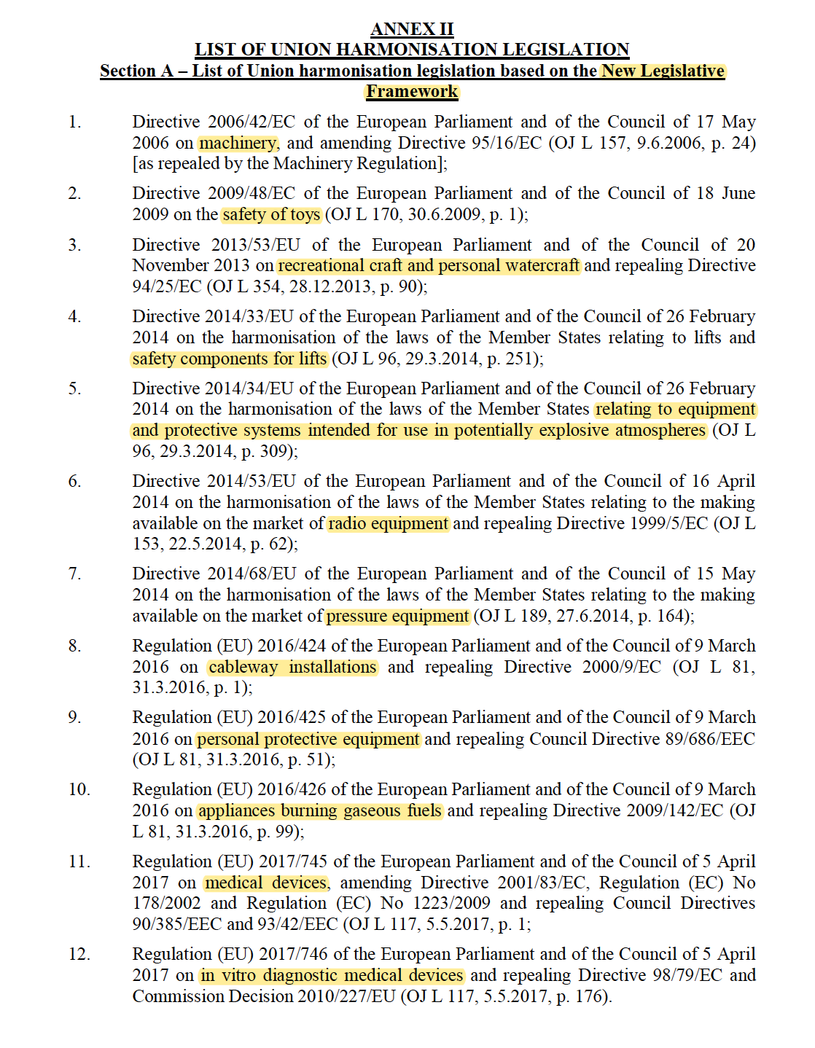
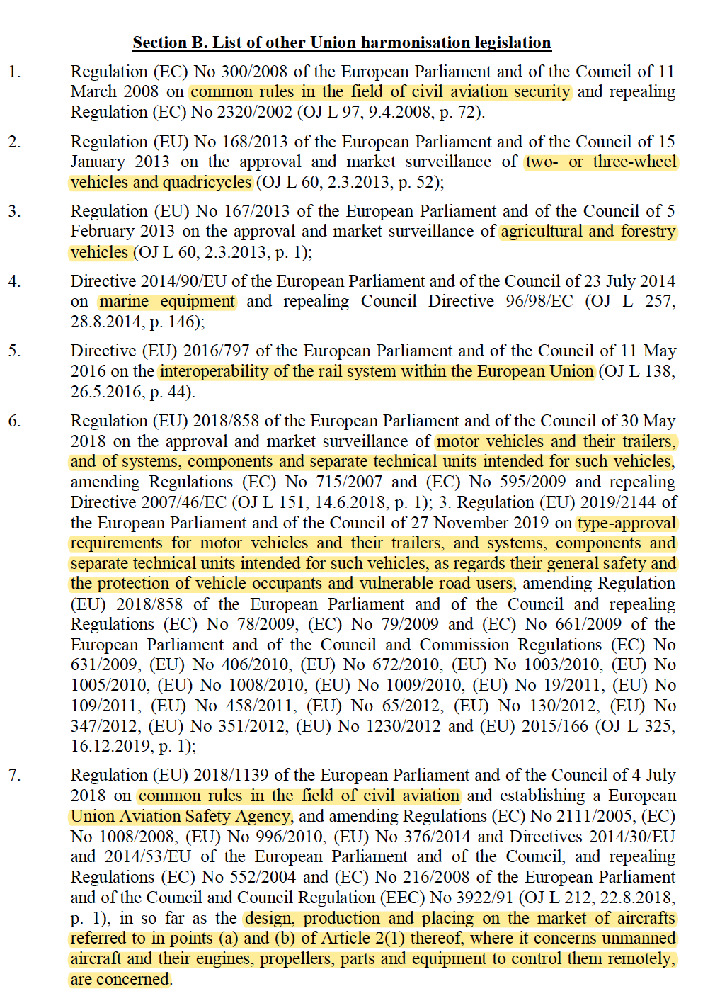

Slide 6
Chapter 1
Art. 6.2
In addition to the high-risk AI systems referred to in paragraph 1, AI systems referred to in Annex III shall also be considered high-risk.

Slide 7
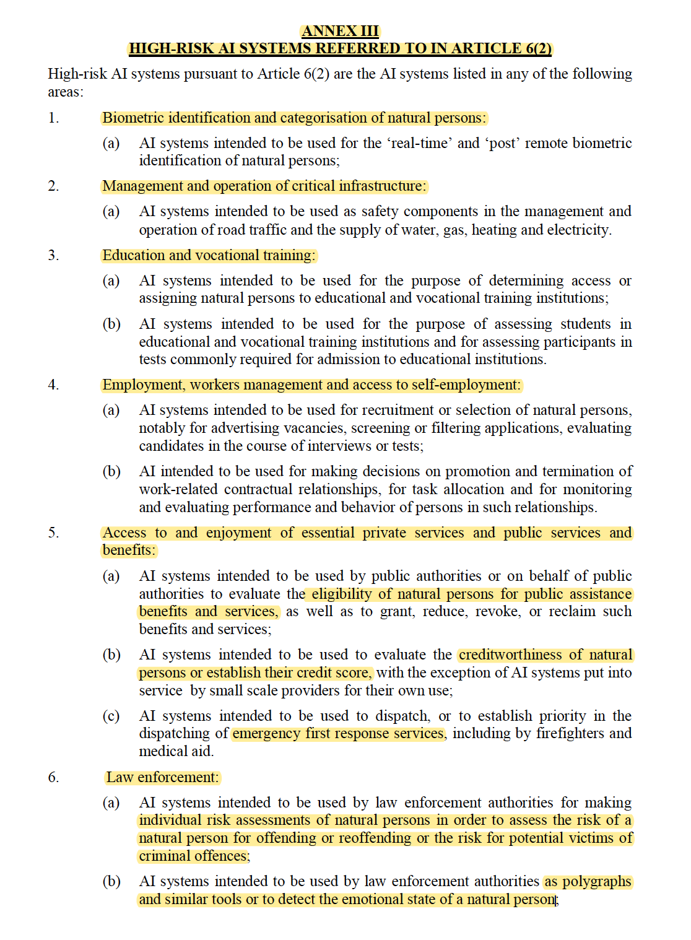
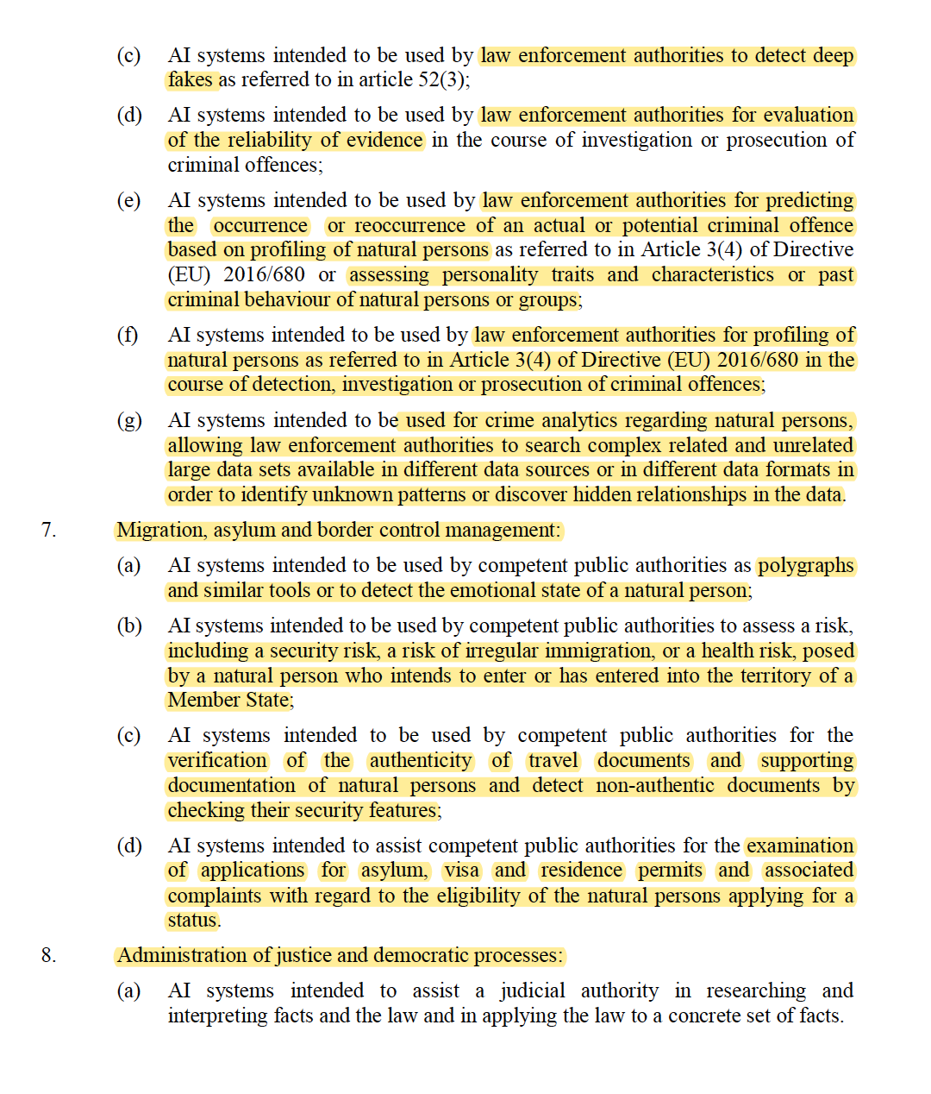

Slide 8

HumanE-AI-NET
AI Act: enables, prohibits, restricts
  Reasonable?
  Pertinent?

