Slide 1
Principles (what rules apply?) art. 5 GDPR

Slide 3
GDPR art. 5: Principles relating to processing of personal data
1.Personal data shall be:
processed lawfully, fairly and in a transparent manner in relation to the data subject (‘lawfulness, fairness and transparency’);

Slide 4
GDPR art. 5: Principles relating to processing of personal data
1.Personal data shall be:
collected for specified, explicit and legitimate purposes and not further processed in a manner that is incompatible with those purposes; further processing for archiving purposes in the public interest, scientific or historical research purposes or statistical purposes shall, in accordance with Article 89(1), not be considered to be incompatible with the initial purposes (‘purpose limitation’);

Slide 5
GDPR art. 5: Principles relating to processing of personal data
1.Personal data shall be:
adequate, relevant and limited to what is necessary in relation to the purposes for which they are processed (‘data minimisation’);

Slide 6
GDPR art. 5: Principles relating to processing of personal data
1.Personal data shall be:
accurate and, where necessary, kept up to date; every reasonable step must be taken to ensure that personal data that are inaccurate, having regard to the purposes for which they are processed, are erased or rectified without delay (‘accuracy’);

Slide 7
GDPR art. 5: Principles relating to processing of personal data
1.Personal data shall be:
kept in a form which permits identification of data subjects for no longer than is necessary for the purposes for which the personal data are processed;
personal data may be stored for longer periods insofar as the personal data will be processed solely for archiving purposes in the public interest, scientific or historical research purposes or statistical purposes in accordance with Article 89(1) subject to implementation of the appropriate technical and organisational measures required by this Regulation in order to safeguard the rights and freedoms of the data subject (‘storage limitation’);

Slide 8
GDPR art. 5: Principles relating to processing of personal data
1.Personal data shall be:
processed in a manner that ensures appropriate security of the personal data, including protection against unauthorised or unlawful processing and against accidental loss, destruction or damage, using appropriate technical or organisational measures (‘integrity and confidentiality’).

Slide 9
GDPR art. 5: Principles relating to processing of personal data
2. The controller shall be responsible for, and be able to demonstrate compliance with, paragraph 1 (‘accountability’).

Slide 10
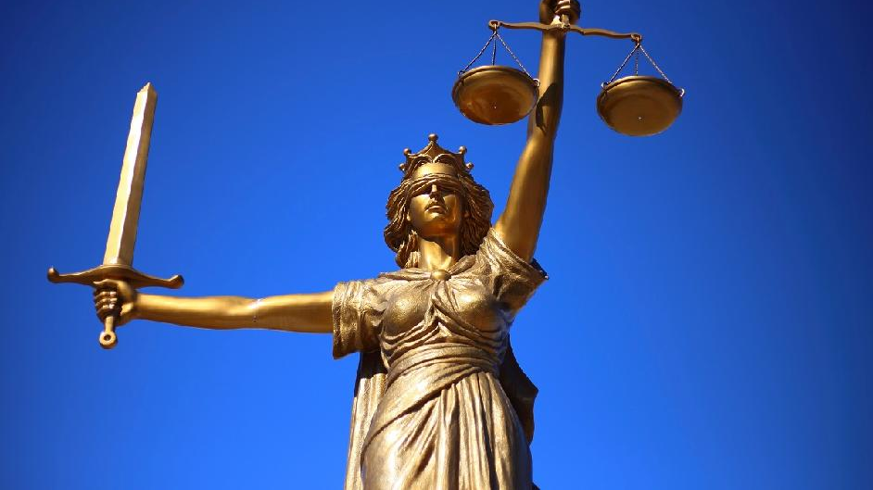
HumanE-AI-NET
GDPR: enables, prohibits, restricts
Reasonable
Pertinent

